Slide 1


Exploratory Data Analysis on : Repaying the credit
Gold Atlantis
MENTORS:
Mrs. Rupali Waykole Ma’am
Mrs. Sharayoo dixit Ma’am
SUBMITTED BY:
Sumit

Slide 2


AGENDA
To find patterns of consumers who have lower probability to become a defaulter.
Level 1 : Univariate Analysis
Level 2 : Bi-variate Analysis
Lever 3 : Multivariate Analysis

Slide 3

Factors to consider in loan application
Days Employed
Total documents Submitted
Occupation Type
Amount Income Total
Name Contract Type
Car
House
Amount credit

Slide 4
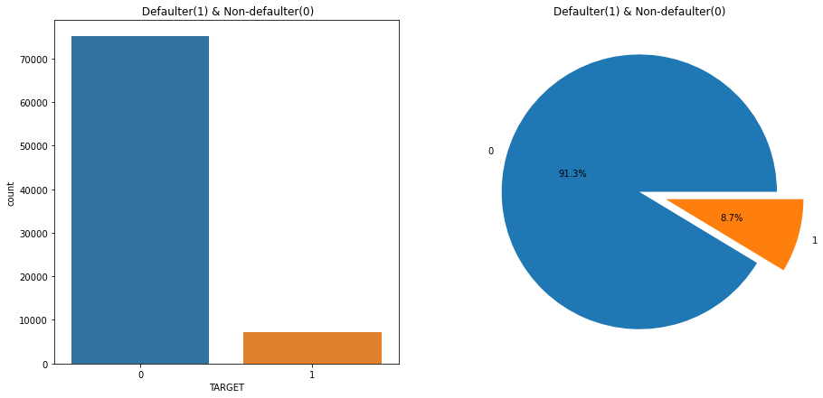
Defaulter and non-defaulters
Level 1
Around 8.7% of the clients are irregular with their credit payments.

Slide 5
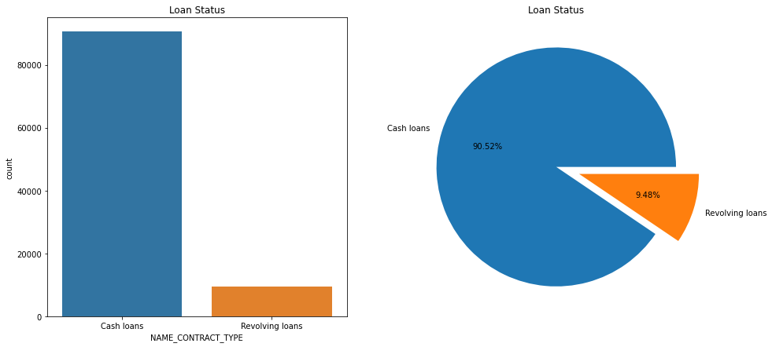
Contract types
Level 1
90.52% customers take cash loans and 9.48% take revolving loans.

Slide 6
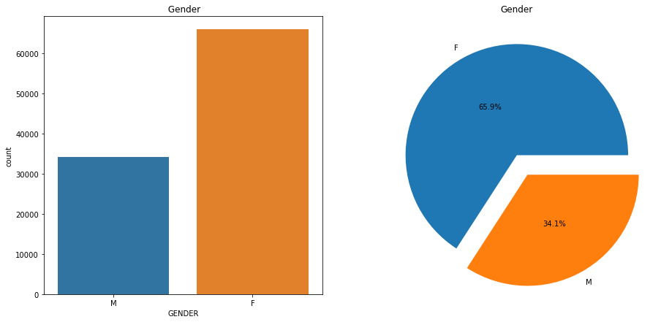
Males and Females
Level 1
Majority of 65.9% of the customers are females.

Slide 7
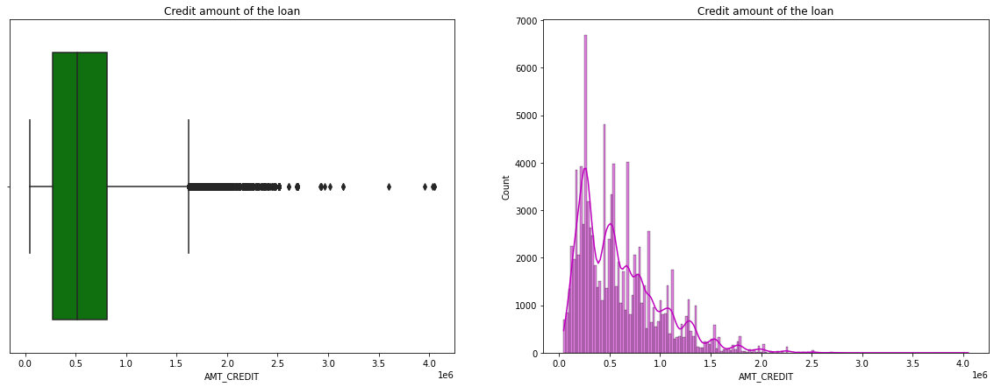
Analysis of AMT_CREDIT
Level 1
Average credit amount is around 6 lacs with the majority of clients having credit amount less than 6 lacs.

Slide 8
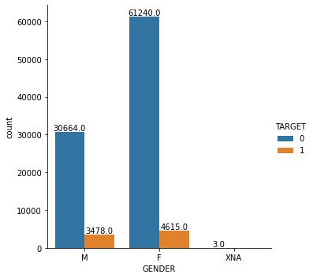
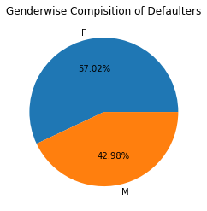
Target wise gender i.e, 0-Regular , 1-Defaulter
Gender wise defaulter %
Level 2
1) More number of female customers are found to be defaulters as compared to male customers.
2) However gender wise Defaulter % is higher for female.

Slide 9
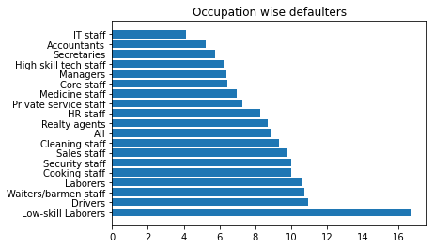
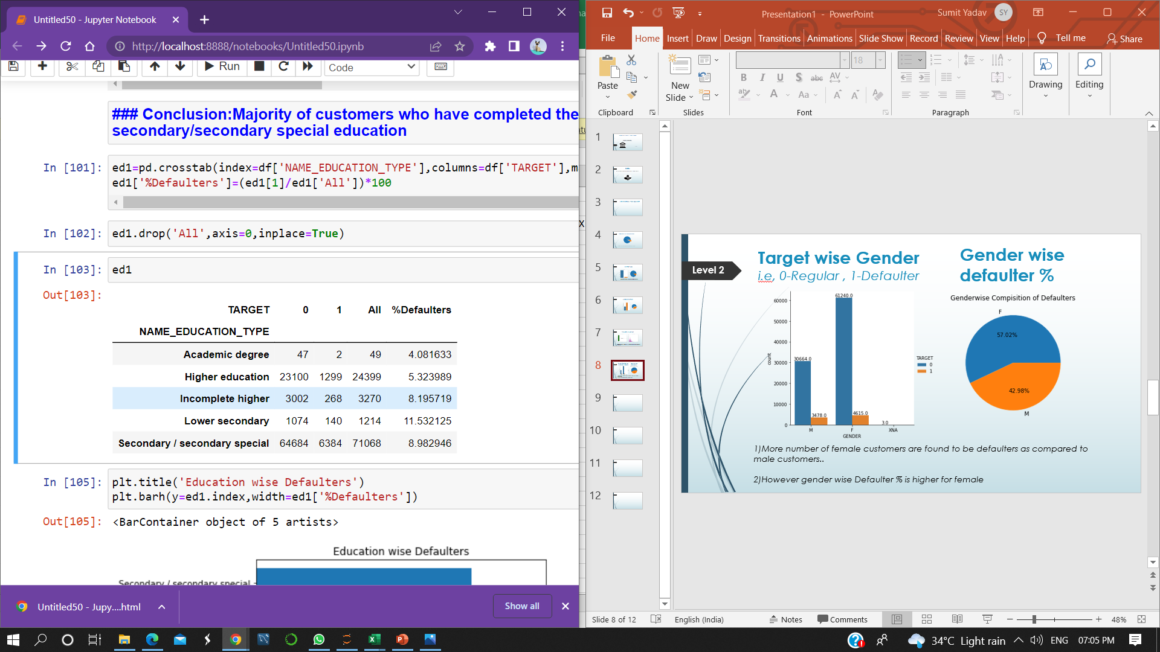
Analyse the defaulters
Level 2
Education wise defaulter
Occupation wise defaulter
1) Education wise the lower secondary education type (%wise) forms a majority of defaulters.
2) Occupation wise the Low skill Laborers (%wise) forms a majority of defaulters.

Slide 10
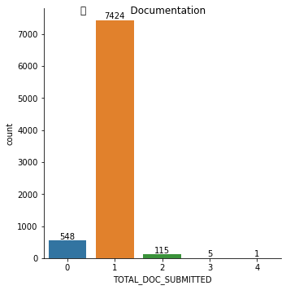
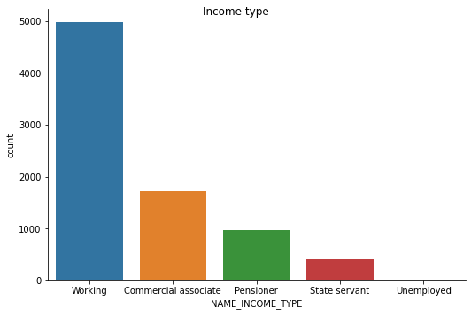
Total documents submitted
Level 2
Analysis of income type
Majority of defaulters have submitted just zero and one document.
Majority of defaulters are from working income type but state servants customers are less defaulters.

Slide 11
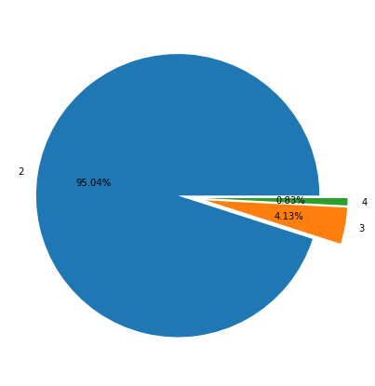
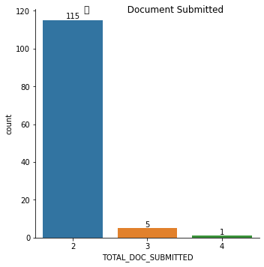
Customer having less chance to become defaulter on the basis of documents submitted
Level 2
Customers who are in the category of defaulters but having the lower probability to become defaulter.

Slide 12
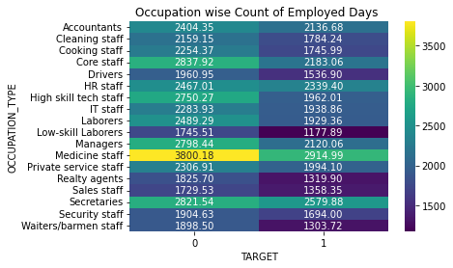
Analyzing the occupation wise count of employed days with target
Level 3
For customers making the irregular payments, the average employed days are less than the ones who are regular with their payments.

Slide 13
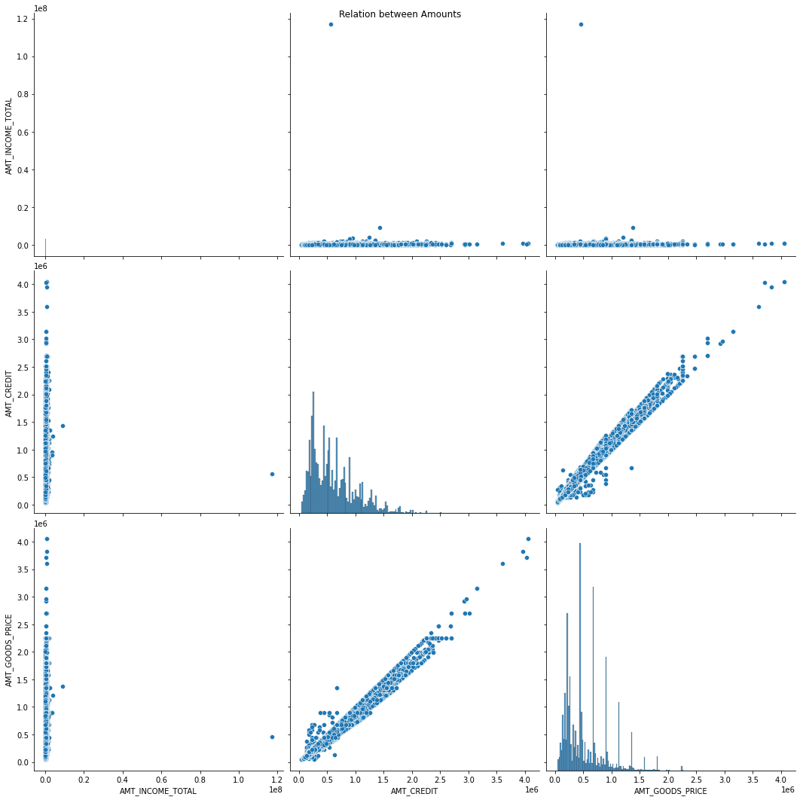
Relation b/w the total amount of credit, good, income.
Level 3
amt_credit and amt_goods_price are corelated to each other.
As goods price increases, credit price also increases.

Slide 14
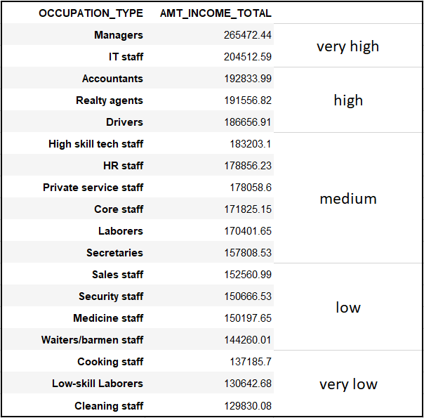
Occupation type with average income
Level 3

Slide 15
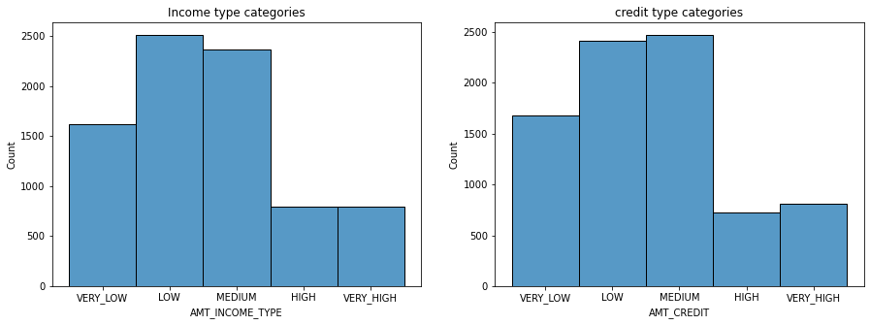
Category wise income type and credit limit
Level 3
Clients who are having medium salary are mostly applied for the loan.
Those customers who are having category between high and very high are having lower probability to become defaulter.

Slide 16
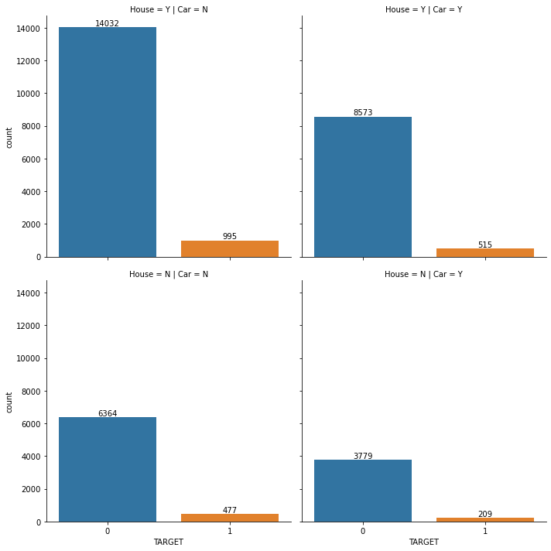
Customers experience more than 5years having house and car
Level 3

Slide 17
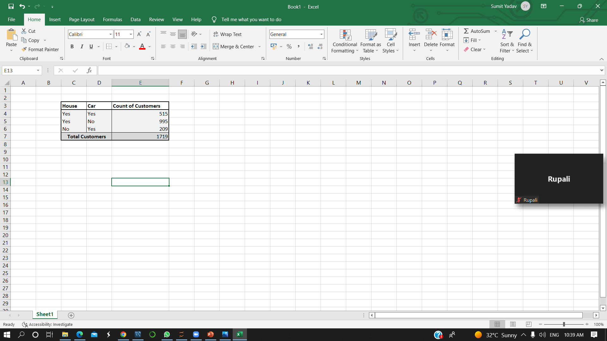
Customers having lower Prob. to become defaulter
Out of total customers these customers(1719) have the less chances to become a defaulter.
The percentage of defaulter customers was 8.7% which is 8092 customers but after EDA the percentage got decreases to 6.3%which is 6373.

Slide 18
Conclusion
After considering all the factors we can say that 93.6% of customers having lower probability to becoming a defaulter and there will be less financial loss to the firm.
The remaining(6.3%) customers are defaulters and if the bank approve the loan then there will be the financial loss to the firm.
Criteria consider for not become a Defaulter :
Days employed more than 5years.
Submitted atleast 2 valid document.
Customer should submit atleast one document of car or house.
Credit amount less than annual income.
Those customers who are working as a state servants have less chances to become defaulter.

Slide 19
Thank you

